Slide 1


MongoDB : Getting Started
@m3lles | #rstektok #mongodbseries

Slide 2
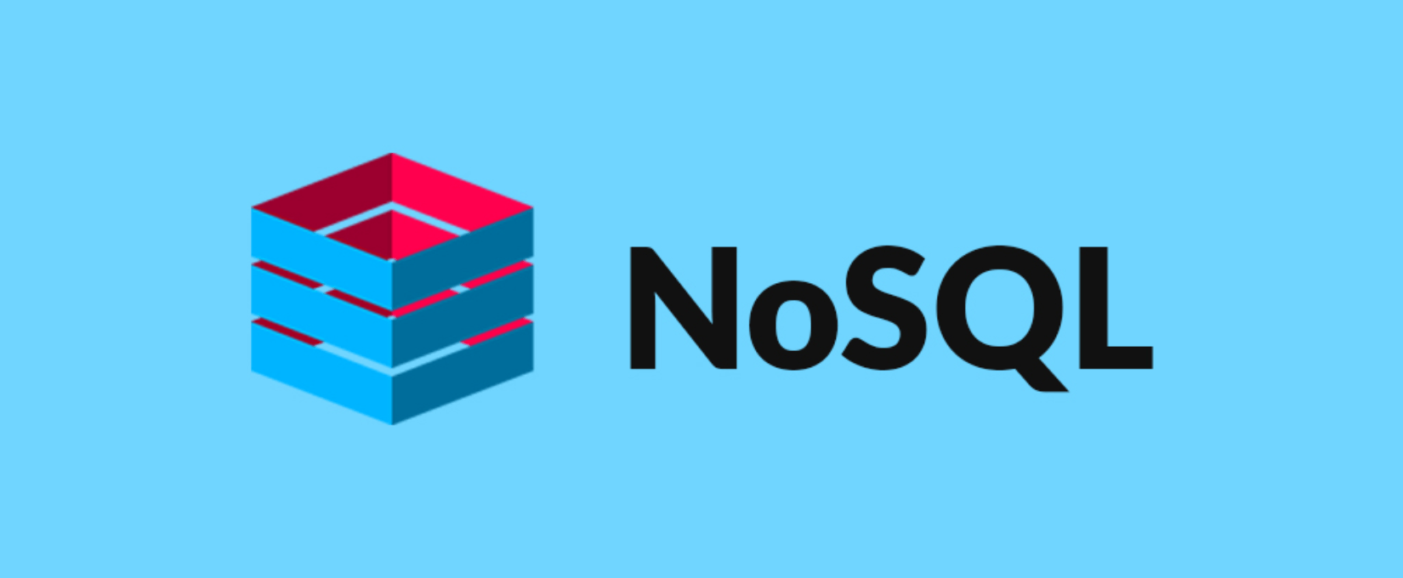
NoSQL Database

Slide 3
What is NoSQL Database?
they typically use it to refer to any non-relational database. Some say the term “NoSQL” stands for “non SQL” while others say it stands for “not only SQL.” Either way, most agree that NoSQL databases are databases that store data in a format other than relational tables.
NoSQL databases “can” store relationship data but they just store it differently than relational databases do
Emerged in the late 2000, where the cost of storage dramatically decreased. Developers (rather than storage) were becoming the primary cost of software development, so NoSQL databases optimized for developer productivity.
@m3lles | #rstektok #mongodbseries

Slide 4
SQL vs NoSQL Database
SQL database are relational | NoSQL databases are non-relational
SQL databases use structured query language and have a predefined schema | NoSQL databases have dynamic schemas for unstructured data.
SQL databases are vertically scalable | NoSQL databases are horizontally scalable
SQL databases are table based | NoSQL databases are document, key-value, graph or wide-column stores
SQL databases are better for multi-row transactions | NoSQL are better for unstructured data like documents or JSON.
SQL database design requires tables to be normalized | Flat is the new normal.
@m3lles | #rstektok #mongodbseries
Notes:
A
- Relational database - represent and store data in tables and rows
- Non-relational database – represent data in collections such as JSON documents
B
- SQL databases use structured query language (SQL) for defining and manipulating data. It’s a powerful language but also restrictive and requires predefined schema.
- NoSQL databases, on the other hand, have dynamic schemas for unstructured data, and data is stored in many ways: They can be column-oriented, document-oriented, graph-based or organized as a KeyValue store. This flexibility means that:
1. You can create documents without having to first define their structure
2. Each document can have its own unique structure
3. The syntax can vary from database to database, and
4. You can add fields as you go.
C
SQL databases are vertically scalable, which means that you can increase the load on a single server by increasing things like CPU, RAM or SSD.
NoSQL databases, on the other hand, are horizontally scalable. This means that you handle more traffic by sharding, or adding more servers in your NoSQL database.
It’s like adding more floors to the same building versus adding more buildings to the neighborhood.

Slide 5
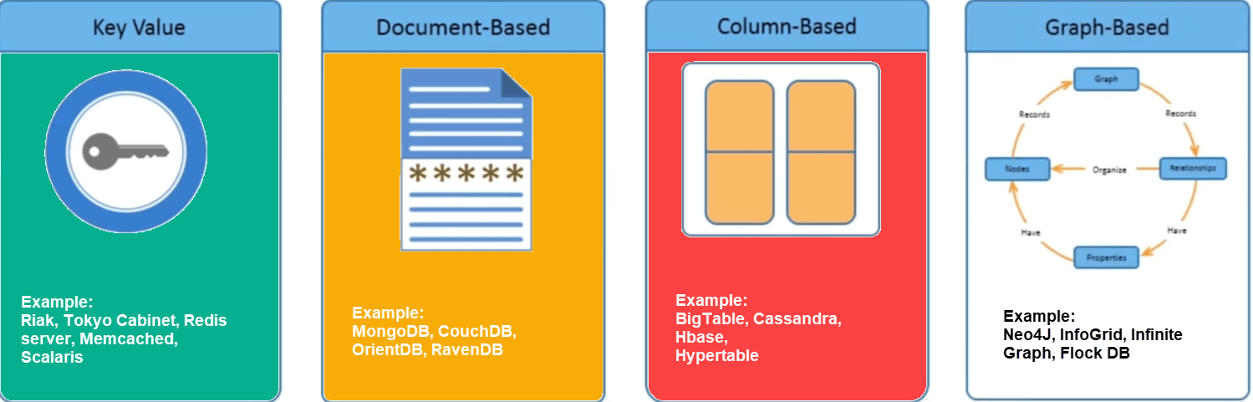
Types of NoSQL Databases
@m3lles | #rstektok #mongodbseries
Notes:
Key Value Stores - Key-value stores are the least complex of the NoSQL databases. They are, as the name suggests, a collection of key-value pairs. Think dictionary.
Document - Document stores are one step up in complexity from key-value stores: a document store does assume a certain document structure that can be specified with a schema. Document stores appear the most natural among the NoSQL database types because they’re designed to store everyday documents as is, and they allow for complex querying and calculations on this often already aggregated form of data.
Column Based - Many consider wide-column stores to be two-dimensional key-value databases. Commonly used in storing IoT data.
Graph - store data in nodes and edges. Nodes typically store information about people, places, and things while edges store information about the relationships between the nodes. Graph databases excel in use cases where you need to traverse relationships to look for patterns such as social networks, fraud detection, and recommendation engines.

Slide 6

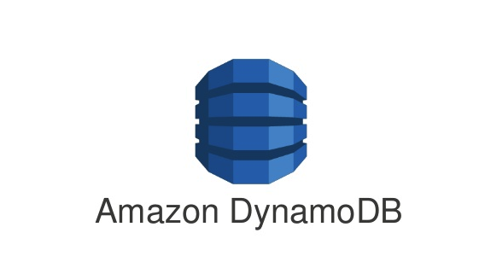






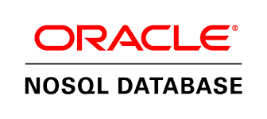



Examples of NoSQL Databases
@m3lles | #rstektok #mongodbseries

Slide 7

Document Oriented NoSQL Databases
@m3lles | #rstektok #mongodbseries

Slide 8
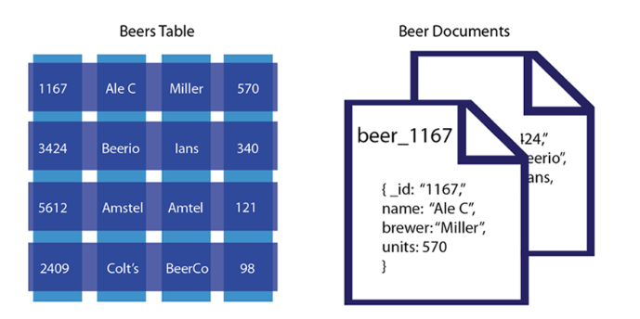
What is a document oriented database?
a document-oriented database contains documents , which are records that describe the data in the document, as well as the actual data. Documents can be as complex as you choose; you can use nested data to provide additional sub-categories of information about your object.
@m3lles | #rstektok #mongodbseries

Slide 9
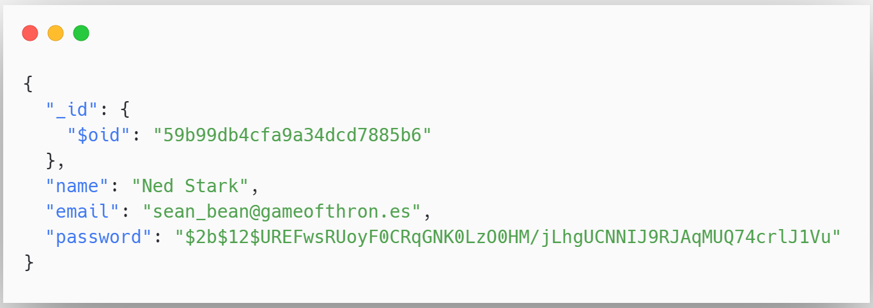
Example
@m3lles | #rstektok #mongodbseries

Slide 10
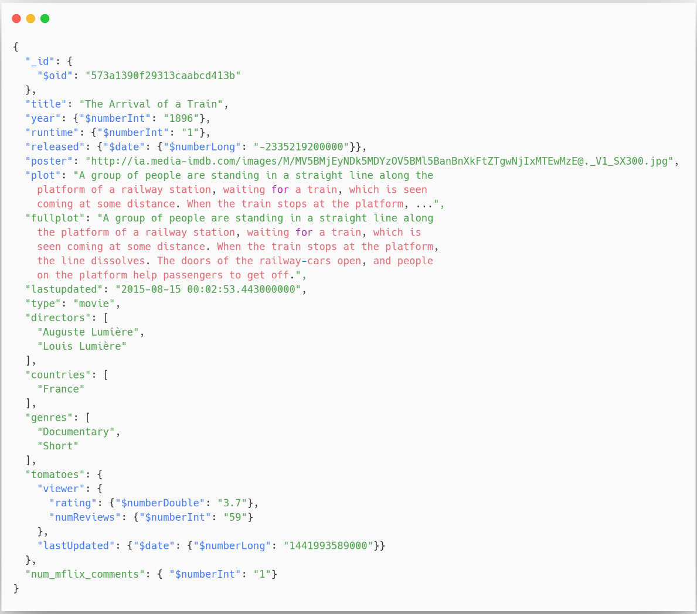
@m3lles | #rstektok #mongodbseries

Slide 11
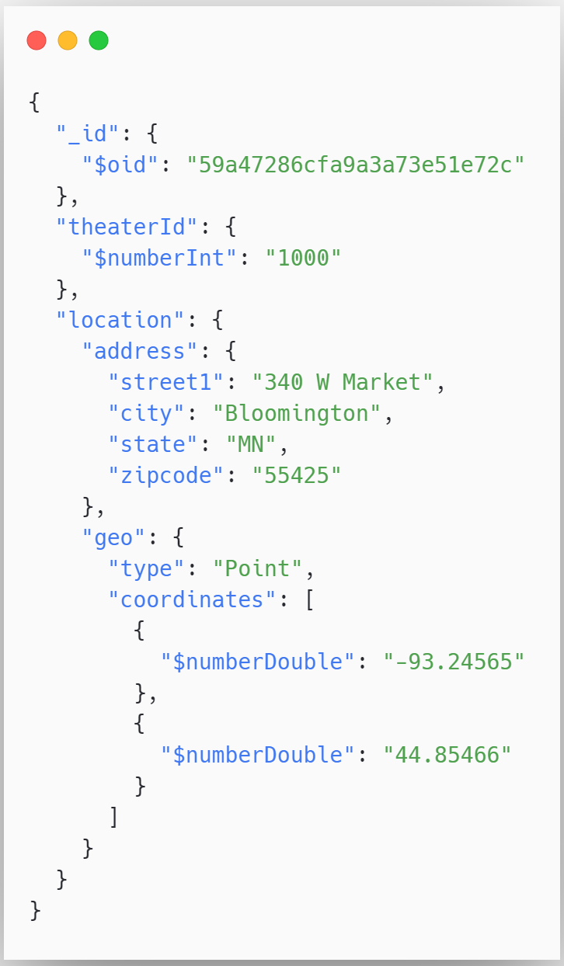
@m3lles | #rstektok #mongodbseries

Slide 12
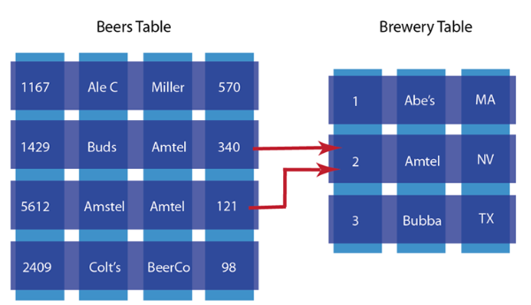
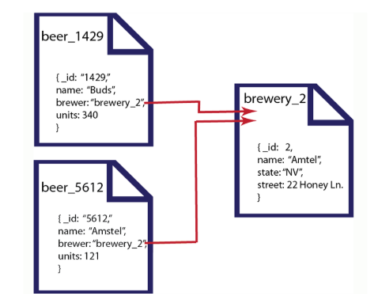
Documents with relationships
@m3lles | #rstektok #mongodbseries

Slide 13
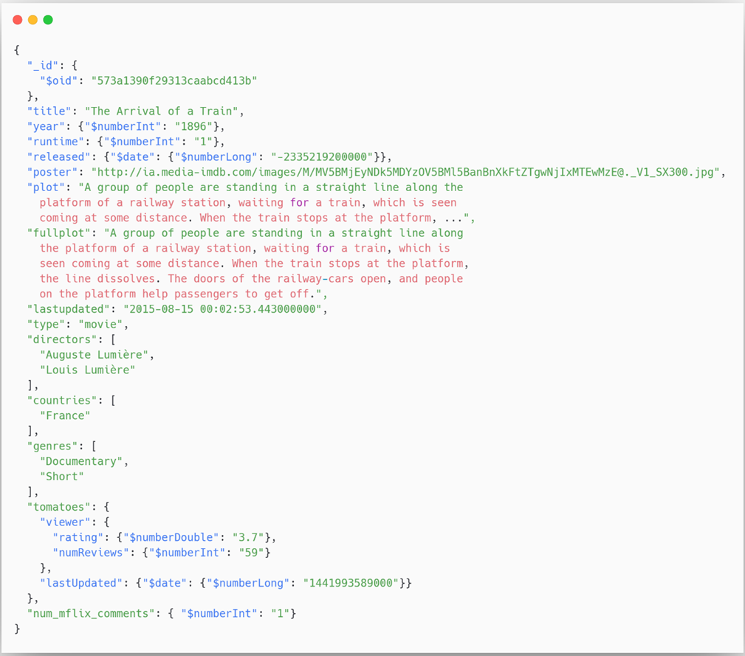
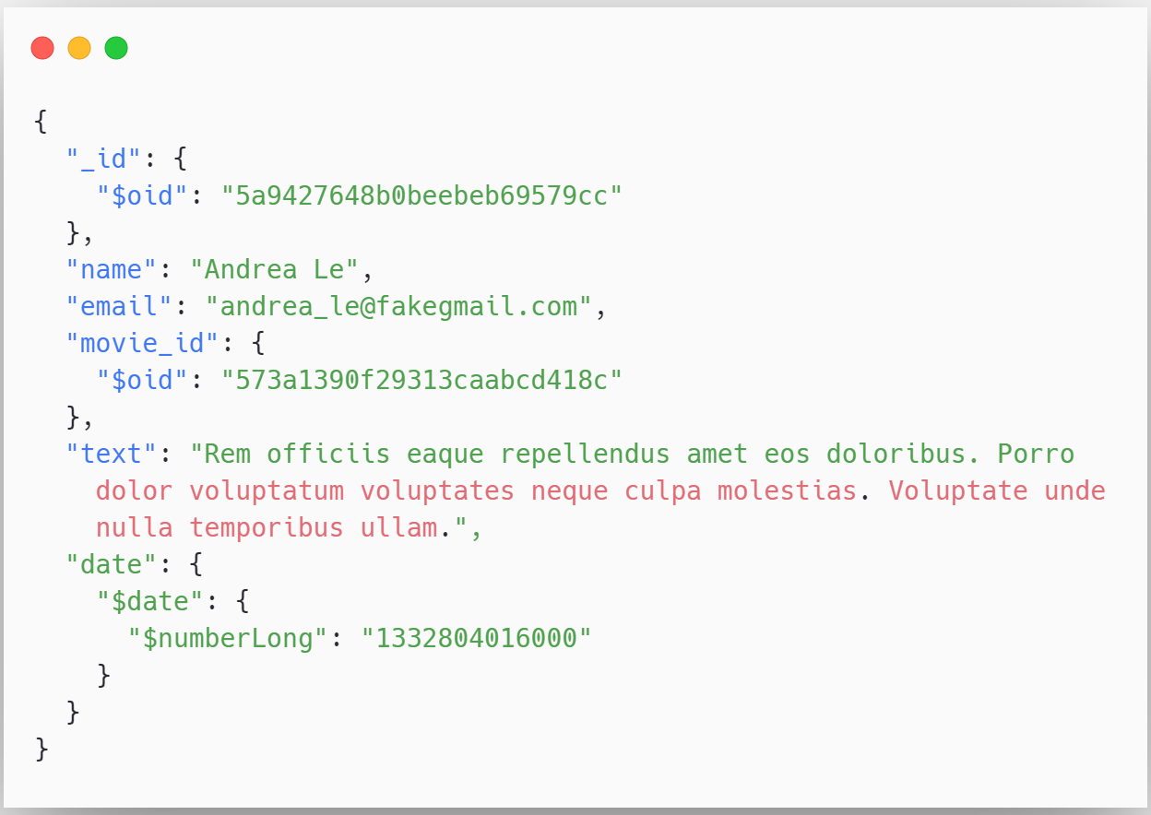
@m3lles | #rstektok #mongodbseries
Notes:
More samples here : https://docs.atlas.mongodb.com/sample-data/available-sample-datasets/

Slide 14

MongoDB
Notes:
https://docs.mongodb.com/guides/

Slide 15
What is MongoDB ?
MongoDB is a general purpose, document-based, distributed database built for modern application developers and for the cloud era.
10gen software company began developing MongoDB in 2007 as a component of a planned platform as a service product. In 2009, the company shifted to an open-source development model, with the company offering commercial support and other services. In 2013, 10gen changed its name to MongoDB Inc.
@m3lles | #rstektok #mongodbseries

Slide 16
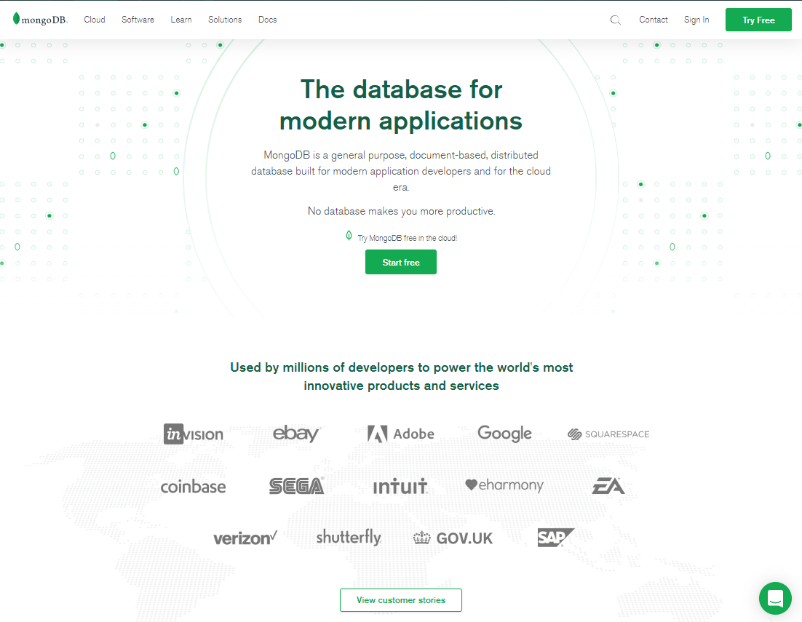
@m3lles | #rstektok #mongodbseries

Slide 17



Common MongoDB Setup
On Premise
On Docks*
On Cloud
Traditional
Modern
@m3lles | #rstektok #mongodbseries

Slide 18
Installation Resources
On Premise - https://www.mongodb.com/try/download/community
On Docks via Docker Hub - https://hub.docker.com/_/mongo
On Cloud - https://www.mongodb.com/cloud/atlas
@m3lles | #rstektok #mongodbseries

Slide 19
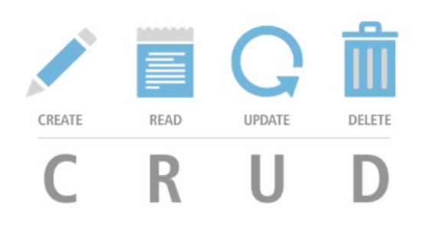
Basic MongoDB Operations

Slide 20
What we need ?
MongoDB Community Server / MongoDB Atlas account
Command Line (preferably Windows Terminal)
MongoDB Compass (optional)
Visual Studio Code (optional)
@m3lles | #rstektok #mongodbseries

Slide 21
MongoDB CLI’s
mongod.exe – main server daemon
mongo.exe – the command line shell that connects to an instance of mongod.
mongos.exe – for the MongoDB Shard
mongorestore.exe - program loads data from either a binary database dump created by mongodump or the standard input (starting in version 3.0.0) into a mongod or mongos instance.
mongodump.exe - is a utility for creating a binary export of the contents of a database
mongoimport.exe – import content from a json, csv or tsv file.
@m3lles | #rstektok #mongodbseries

Slide 22
Getting around the database
show dbs - list databases
use [dbname] - switch to the particular db
show collections – list available collections in the db

Slide 23

Demo
@m3lles | #rstektok #mongodbseries

Slide 24
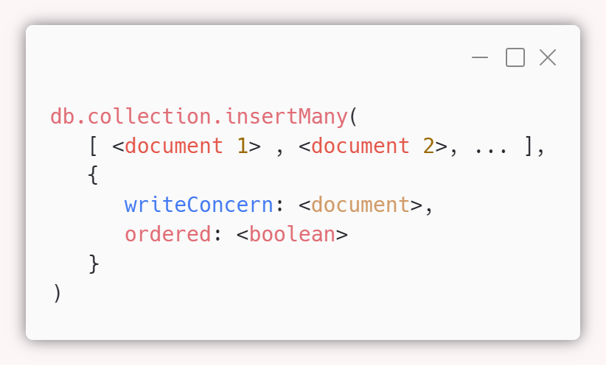
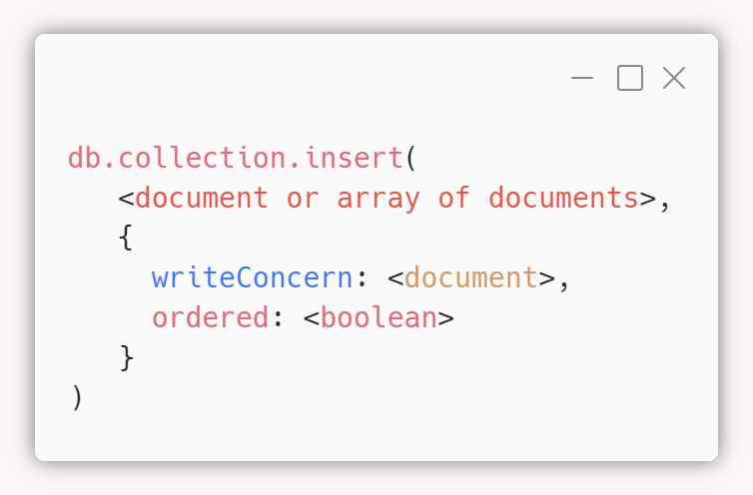
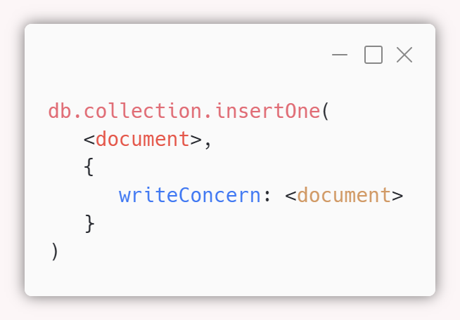
CRUD Operations : Insert
@m3lles | #rstektok #mongodbseries

Slide 25
Demo
@m3lles | #rstektok #mongodbseries

Slide 26
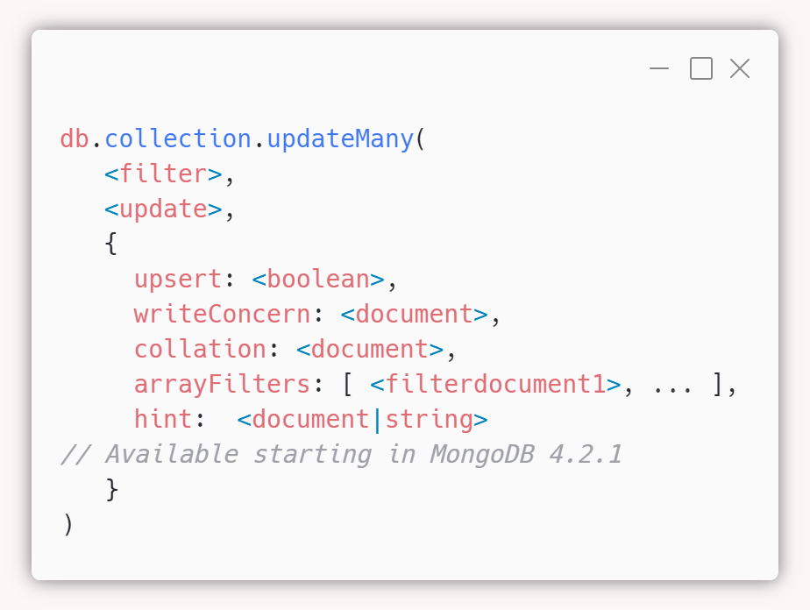
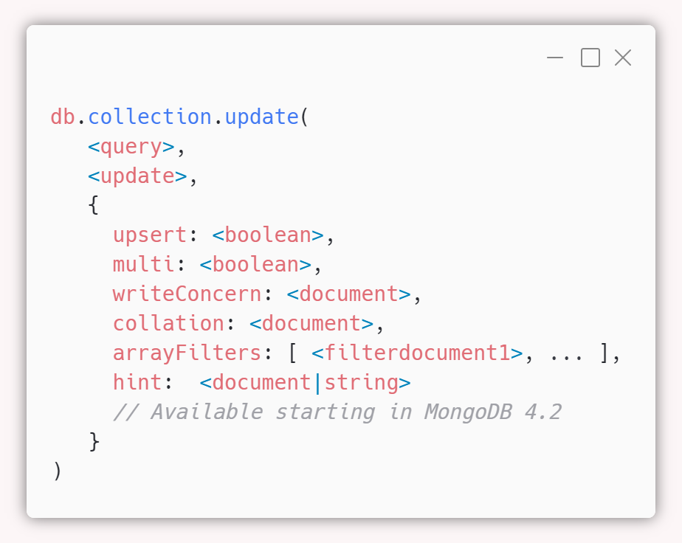
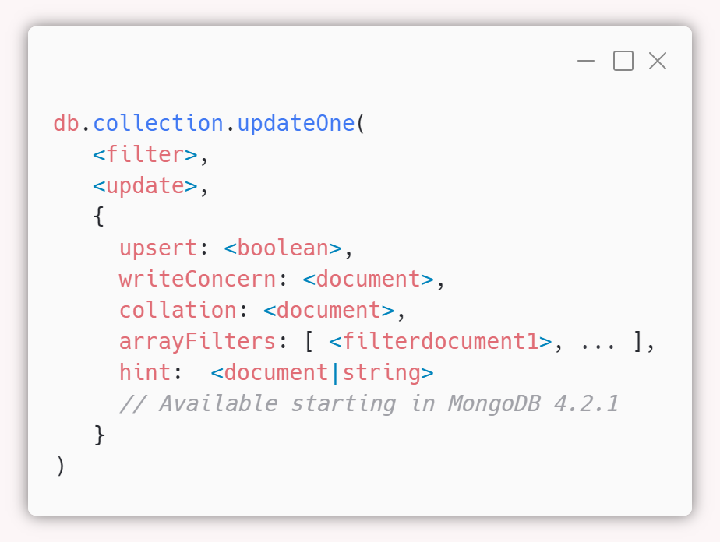
CRUD Operations : Update
@m3lles | #rstektok #mongodbseries

Slide 27
Demo
@m3lles | #rstektok #mongodbseries

Slide 28
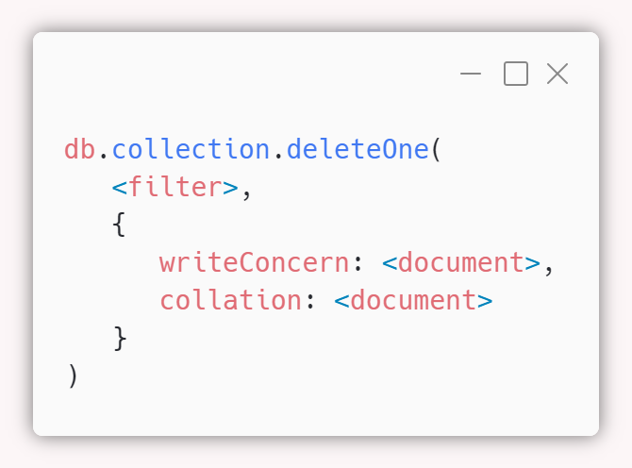
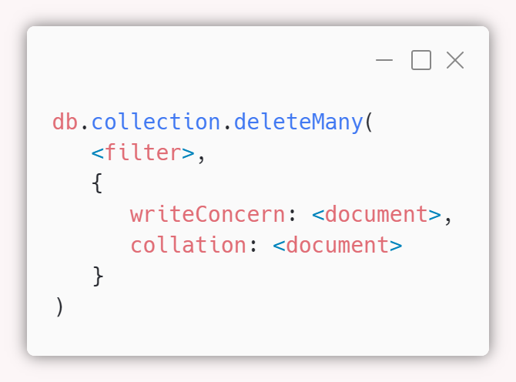
CRUD Operations : Delete
@m3lles | #rstektok #mongodbseries

Slide 29
Demo
@m3lles | #rstektok #mongodbseries

Slide 30
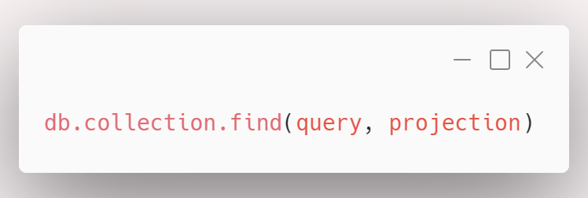
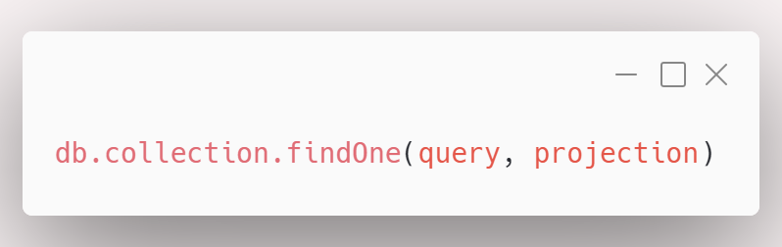
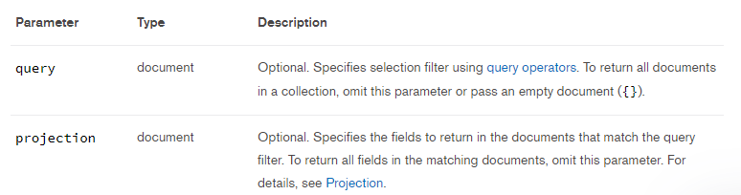
CRUD Operations : Retrieve
@m3lles | #rstektok #mongodbseries

Slide 31
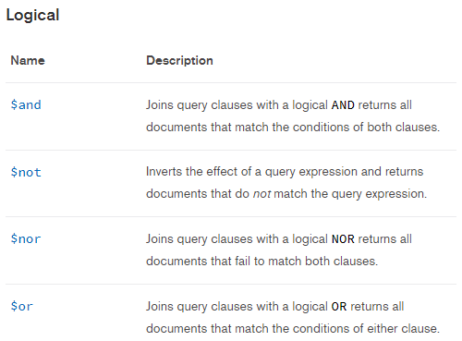
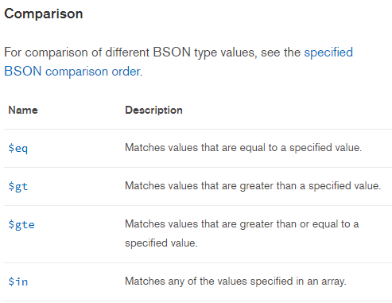
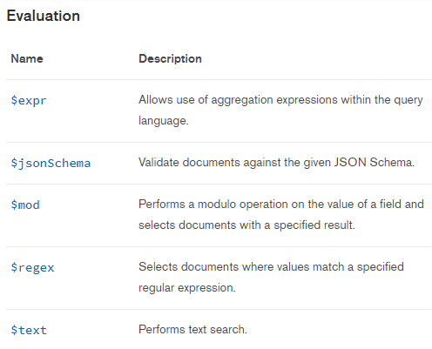
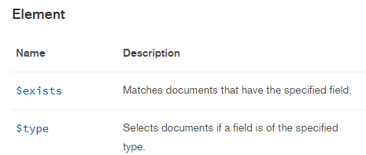
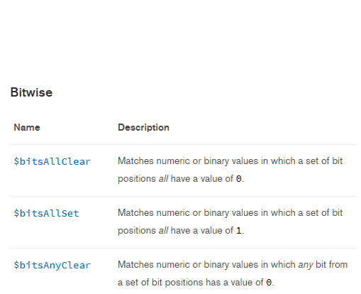
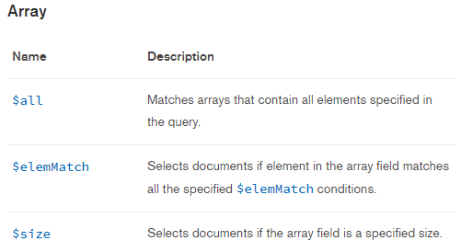
Retrieve : Query Selectors
@m3lles | #rstektok #mongodbseries

Slide 32
Demo
@m3lles | #rstektok #mongodbseries

Slide 33
Aggregations
Aggregation operations process data records and return computed results. Aggregation operations group values from multiple documents together, and can perform a variety of operations on the grouped data to return a single result.
Aggregation pipeline
Map-reduce
Single purpose aggregation methods
@m3lles | #rstektok #mongodbseries
Notes:
Aggregation - MongoDB’s aggregation pipeline is modeled on the concept of data processing pipelines. Documents enter a multi-stage pipeline that transforms the documents into an aggregated result.
Map-reduce - MongoDB also provides map-reduce operations to perform aggregation. In general, map-reduce operations have two phases: a map stage that processes each document and emits one or more objects for each input document, and reduce phase that combines the output of the map operation. Map-reduce uses custom JavaScript functions to perform the map and reduce operations, as well as the optional finalize operation. While the custom JavaScript provide great flexibility compared to the aggregation pipeline, in general, map-reduce is less efficient and more complex than the aggregation pipeline.
Single Purpose Aggregation Operations - MongoDB also provides db.collection.estimatedDocumentCount(), db.collection.count() and db.collection.distinct().
All of these operations aggregate documents from a single collection. While these operations provide simple access to common aggregation processes, they lack the flexibility and capabilities of the aggregation pipeline and map-reduce.

Slide 34
Aggregation Pipeline
Pipeline is consist of stages ( e.g. $match, $group, $project, $sort, $lookup,)
the aggregate command operates on a single collection, logically passing the entire collection into the aggregation pipeline.
Sample Pipeline
$match
$group
$project
@m3lles | #rstektok #mongodbseries
Notes:
https://docs.mongodb.com/manual/reference/operator/aggregation-pipeline/#aggregation-pipeline-operator-reference

Slide 35
Demo
@m3lles | #rstektok #mongodbseries

Slide 36

Jupyter Notebook

Slide 37
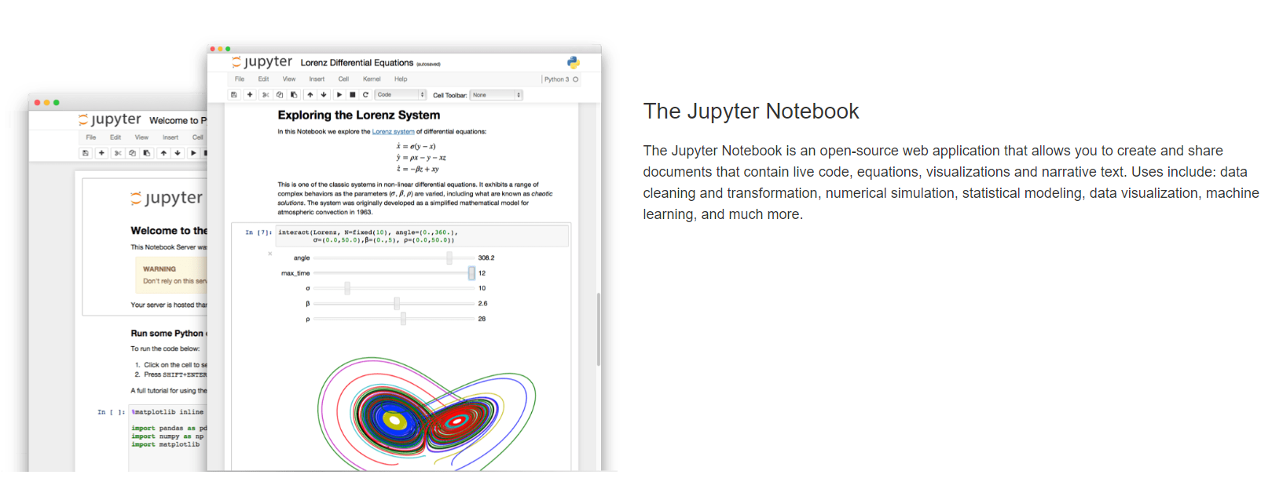
What is this notebook?
@m3lles | #rstektok #mongodbseries
Notes:
Data Wrangling is the process of cleaning, structuring and enriching raw data into a desired format for better decision making in less time.

Slide 38
Demo
@m3lles | #rstektok #mongodbseries

Slide 39
Don’t stop learning
Don’t stop building
Personal projects
Volunteer works
Hackathons
Collaborations
Share your knowledge
“human knowledge belongs to the world”
@m3lles | #rstektok #mongodbseries

